Slide 1
Supporting Ad-Hoc Ranking Aggregates
Chengkai Li (UIUC)
joint work with
Kevin Chang (UIUC) Ihab Ilyas (Waterloo)

Slide 2
Ranking (Top-k) Queries
Find the top k answers with respect to a ranking function, which often is the aggregation of multiple criteria.
Ranking is important in many database applications:
E-Commerce
Find the best hotel deals by price, distance, etc.
Multimedia Databases
Find the most similar images by color, shape, texture, etc.
Search Engine
Find the most relevant records/documents/pages.
OLAP, Decision Support
Find the top profitable customers to send ads.

Slide 3
RankSQL: a RDBMS with Efficient Support of Ranking Queries
Rank-Aware Query Operators [SIGMOD02, VLDB03]
Algebraic Foundation and Optimization Framework [SIGMOD04, SIGMOD05]
  SPJ queries (SELECT … FROM … WHERE … ORDER BY …)
Ad-Hoc Ranking Aggregate Queries [SIGMOD06]
top k groups instead of tuples.
  (SELECT … FROM … WHERE … GROUP BY … ORDER BY …)

Slide 4
Example 1: Advertising an insurance product
What are the top 5 areas to advertise a new insurance product?
SELECT zipcode,
AVG(income*w1+age*w2+credit*w3) as score
FROM customer
WHERE occupation=‘student’
GROUP BY zipcode
ORDER BY score
LIMIT 5

Slide 5
Example 2: Finding the most profitable combinations
What are the 5 most profitable pairs of (product category, sales area)?
SELECT P.cateogy, S.zipcode,
MID_SUM(S.price - P.manufact_price)
as score
FROM products P, sales S
WHERE P.p_key=S.p_key
GROUP BY P.category, S.zipcode
ORDER BY score
LIMIT 5

Slide 6
Ad-Hoc Ranking
Ranking Condition : F=G(T)
e.g. AVG (income*w1+age*w2+credit*w3)
MID_SUM (S.price - P.manufact_price)
G: group-aggregate function
  Standard (e.g., sum, avg)
  User-defined (e.g., mid_sum)
T: tuple-aggregate function
  arbitrary expression
  e.g., AVG (income*w1+age*w2+credit*w3),
  w1, w2, w3 can be any values.

Slide 7
Why “Ad-Hoc”?
DSS applications are exploratory and interactive:
Decision makers try out various ranking criteria
Results of a query as the basis for further queries
It requires efficient techniques for fast response

Slide 8
Existing Techniques
Data Cube / Materialized Views:
pre-computation
  The views may not be built for the G:
  e.g., mid_sum cannot be derived from sum, avg, etc.
  The views may not be built for the T:
  e.g., a+b does not help in doing a*b, and vice versa.
Materialize-Group-Sort:
from the scratch

Slide 9
Materialize-Group-Sort Approach
Select zipcode, AVG(income
*w1+age*w2+credit*w3)
as score
From Customer
Where
occupation=‘student’
Group By zipcode
Order By score
Limit 5
5 results
R
sorting
G
grouping
B
Boolean

Slide 10
Problems of Materialize-Group-Sort
Overkill:
Total order of all groups, although only top 5 are requested.
Inefficient:
Full materialization (scan, join, grouping, sorting).
all groups
(materialized)
sort
group
all tuples
(materialized)
Boolean operators
(a) Traditional query plan.

Slide 11
Can We Do Better?
Without any further info, full materialization is all that we can do.
Can we do better:
  What info do we need?
  How to use the info?
all groups
(materialized)
sort
group
all tuples
(materialized)
Boolean operators
(a) Traditional query plan.

Slide 12
RankAgg vs. Materialize-Group-Sort
Goal: minimize the number of tuples processed. (Partial vs. full materialization)
all groups
(materialized)
group g₁
group g₂
sort
(incremental)
agg
group
tuple x₁
tuple x₂
all tuples
(materialized)
(incremental)
Boolean operators
rank- & group-aware operators
(a) Traditional query plan.
(b) New query plan.

Slide 13
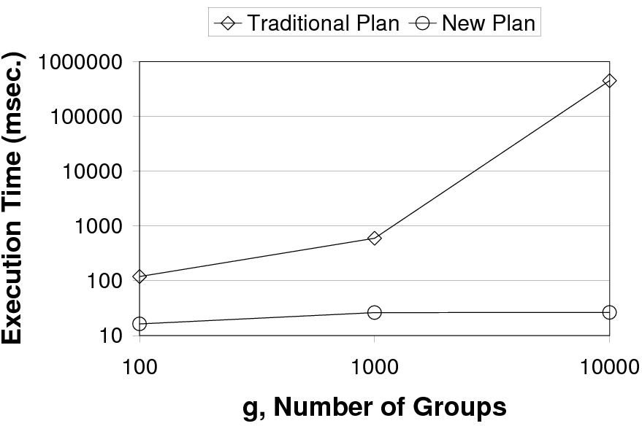
Orders of Magnitude Performance Improvement

Slide 14
The Principles of RankAgg
Can we do better? Upper-Bound Principle: best-possible goal
There is a certain minimal number of tuples to retrieve before we can stop.
What info do we need? Upper-Bound Principle: must-have info
A non-trivial upper-bound is a must. (e.g., +infinity will not save anything.)
Upper-bound of a group indicates the best a group can achieve, thus tells us if it is going to make top-k or not.
How to use the info?
  Group-Ranking Principle: Process the most promising group first.
  Tuple-Ranking Principle: Retrieve tuples in a group in the order of T.
Together: Optimal Aggregate Processing
minimal number of tuples processed.

Slide 15
Running Example
Select g, SUM(v)
From R
Group By g
Order By SUM(v)
Limit 1
TID |  | R.g | R.v
r₁ |  | 1 | .7
r₂ |  | 2 | .3
r₃ |  | 3 | .9
r₄ |  | 2 | .4
r₅ |  | 1 | .9
r₆ |  | 3 | .7
r₇ |  | 1 | .6
r₈ |  | 2 | .25

Slide 16
Must-Have Information
Assumptions for getting a non-trivial upper-bound:
We focus on a (large) class of max-bounded function:
F[g] can be obtained by applying G over the maximal T of g’s members.
We have the size of each group. (Will get back to this.)
We can obtain the maximal value of T. (In the example,
v <= 1.)

Slide 17
Example: Group-Ranking Principle
Process the most promising group first.
agg
group-aware
scan
TID |  | R.g | R.v
r₁ |  | 1 | .7
r₅ |  | 1 | .9
r₇ |  | 1 | .6
TID |  | R.g | R.v
r₂ |  | 2 | .3
r₄ |  | 2 | .4
r₈ |  | 2 | .25
TID |  | R.g | R.v
r₃ |  | 3 | .9
r₆ |  | 3 | .7
R

Slide 18


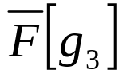
Example: Group-Ranking Principle
Process the most promising group first.
action
initial |  | 3.0 | 3.0 | 2.0
agg
group-aware
scan
TID |  | R.g | R.v
r₁ |  | 1 | .7
r₅ |  | 1 | .9
r₇ |  | 1 | .6
TID |  | R.g | R.v
r₂ |  | 2 | .3
r₄ |  | 2 | .4
r₈ |  | 2 | .25
TID |  | R.g | R.v
r₃ |  | 3 | .9
r₆ |  | 3 | .7
R

Slide 19
Example: Group-Ranking Principle
Process the most promising group first.
action
initial |  | 3.0 | 3.0 | 2.0
(r₁, 1, .7) |  | 2.7 | 3.0 | 2.0
agg
group-aware
scan
TID |  | R.g | R.v
r₅ |  | 1 | .9
r₇ |  | 1 | .6
TID |  | R.g | R.v
r₂ |  | 2 | .3
r₄ |  | 2 | .4
r₈ |  | 2 | .25
TID |  | R.g | R.v
r₃ |  | 3 | .9
r₆ |  | 3 | .7
R

Slide 20
Example: Group-Ranking Principle
Process the most promising group first.
action
initial |  | 3.0 | 3.0 | 2.0
(r₁, 1, .7) |  | 2.7 | 3.0 | 2.0
(r₂, 2, .3) |  | 2.7 | 2.3 | 2.0
agg
group-aware
scan
TID |  | R.g | R.v
r₅ |  | 1 | .9
r₇ |  | 1 | .6
TID |  | R.g | R.v
r₄ |  | 2 | .4
r₈ |  | 2 | .25
TID |  | R.g | R.v
r₃ |  | 3 | .9
r₆ |  | 3 | .7
R

Slide 21
Example: Group-Ranking Principle
Process the most promising group first.
action
initial |  | 3.0 | 3.0 | 2.0
(r₁, 1, .7) |  | 2.7 | 3.0 | 2.0
(r₂, 2, .3) |  | 2.7 | 2.3 | 2.0
(r₅, 1, .9) |  | 2.6 | 2.3 | 2.0
agg
group-aware
scan
TID |  | R.g | R.v
r₇ |  | 1 | .6
TID |  | R.g | R.v
r₄ |  | 2 | .4
r₈ |  | 2 | .25
TID |  | R.g | R.v
r₃ |  | 3 | .9
r₆ |  | 3 | .7
R

Slide 22
Example: Group-Ranking Principle
Process the most promising group first.
action
initial |  | 3.0 | 3.0 | 2.0
(r₁, 1, .7) |  | 2.7 | 3.0 | 2.0
(r₂, 2, .3) |  | 2.7 | 2.3 | 2.0
(r₅, 1, .9) |  | 2.6 | 2.3 | 2.0
(r₇, 1, .6) |  | 2.2 | 2.3 | 2.0
agg
group-aware
scan
TID |  | R.g | R.v
TID |  | R.g | R.v
r₄ |  | 2 | .4
r₈ |  | 2 | .25
TID |  | R.g | R.v
r₃ |  | 3 | .9
r₆ |  | 3 | .7
R

Slide 23
Example: Group-Ranking Principle
Process the most promising group first.
action
initial |  | 3.0 | 3.0 | 2.0
(r₁, 1, .7) |  | 2.7 | 3.0 | 2.0
(r₂, 2, .3) |  | 2.7 | 2.3 | 2.0
(r₅, 1, .9) |  | 2.6 | 2.3 | 2.0
(r₇, 1, .6) |  | 2.2 | 2.3 | 2.0
(r₄, 2, .4) |  | 2.2 | 1.7 | 2.0
agg
group-aware
scan
R
TID |  | R.g | R.v
TID |  | R.g | R.v
r₈ |  | 2 | .25
TID |  | R.g | R.v
r₃ |  | 3 | .9
r₆ |  | 3 | .7

Slide 24
Example: Tuple-Ranking Principle
Retrieve tuples within a group in the order of tuple-aggregate function T.
agg
group &
rank-aware
scan
TID |  | R.g | R.v
r₂ |  | 2 | .3
r₄ |  | 2 | .4
r₈ |  | 2 | .25
TID |  | R.g | R.v
r₄ |  | 2 | .4
r₂ |  | 2 | .3
r₈ |  | 2 | .25
R
not in the order of R.v
in the order of R.v

Slide 25
Example: Tuple-Ranking Principle
Retrieve tuples within a group in the order of tuple-aggregate function T.
action
initial |  | 3.0
action
initial |  | 3.0
agg
group &
rank-aware
scan
TID |  | R.g | R.v
r₂ |  | 2 | .3
r₄ |  | 2 | .4
r₈ |  | 2 | .25
TID |  | R.g | R.v
r₄ |  | 2 | .4
r₂ |  | 2 | .3
r₈ |  | 2 | .25
R
not in the order of R.v
in the order of R.v

Slide 26
Example: Tuple-Ranking Principle
Retrieve tuples within a group in the order of tuple-aggregate function T.
action
initial |  | 3.0
(r₂, 2, .3) |  | 2.3
action
initial |  | 3.0
(r₄, 2, .4) |  | 1.2
agg
group &
rank-aware
scan
TID |  | R.g | R.v
r₄ |  | 2 | .4
r₈ |  | 2 | .25
TID |  | R.g | R.v
r₂ |  | 2 | .3
r₈ |  | 2 | .25
R
not in the order of R.v
in the order of R.v

Slide 27
Example: Tuple-Ranking Principle
Retrieve tuples within a group in the order of tuple-aggregate function T.
action
initial |  | 3.0
(r₂, 2, .3) |  | 2.3
(r₄, 2, .4) |  | 1.7
action
initial |  | 3.0
(r₄, 2, .4) |  | 1.2
(r₂, 2, .3) |  | 1.0
agg
group &
rank-aware
scan
TID |  | R.g | R.v
r₈ |  | 2 | .25
TID |  | R.g | R.v
r₈ |  | 2 | .25
R
not in the order of R.v
in the order of R.v

Slide 28
Implementing the Principles: Obtaining Group Size
Sizes ready:
Though G(T) is ad-hoc, the Boolean conditions are shared in sessions of decision making.
Sizes from materialized information:
Similar queries computed.
Sizes from scratch:
Pay as much as materialize-group-sort for the 1st query; amortized by the future similar queries.

Slide 29
Implementing the Principles: Group-Aware Plans
Current iterator
GetNext( )
agg
operator
GetNext(g)
GetNext(g’)
GetNext(g’’)
New iterator
scan
GetNext(g)
GetNext(g’)
scan
operator

Slide 30
Conclusions
Ranking Aggregate Queries
  Top-k groups
  Ad-Hoc ranking conditions
RankAgg
  Principles
  Upper-Bound, Group-Ranking, and Tuple-Ranking
  Optimal Aggregate Processing
  Minimal number of tuples processed
  Significant performance gains, compared with materialize-group-sort.

